Slide 1


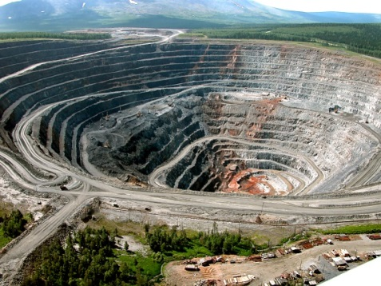
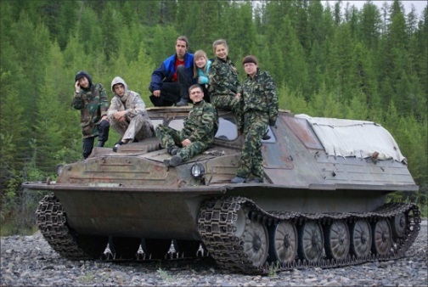
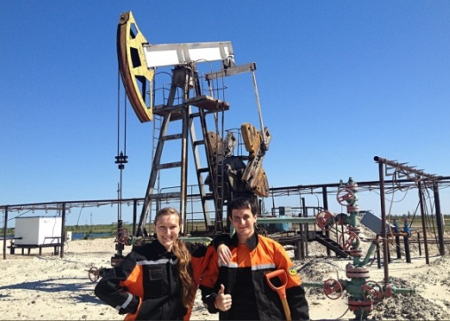
Sampling of mineral deposits

Slide 2
Types of sampling
There are 5 types of sampling:
1. Chemical
2. Mineralogical
3. Technical
4. Technological
5. Geophysical

Slide 3

Chemical Sampling
Serves to study the chemical composition of ores and hosting rocks.
This type of sampling determines the content of the main and associated components.
For the most part, p.i. Chemical testing is fundamental.

Slide 4
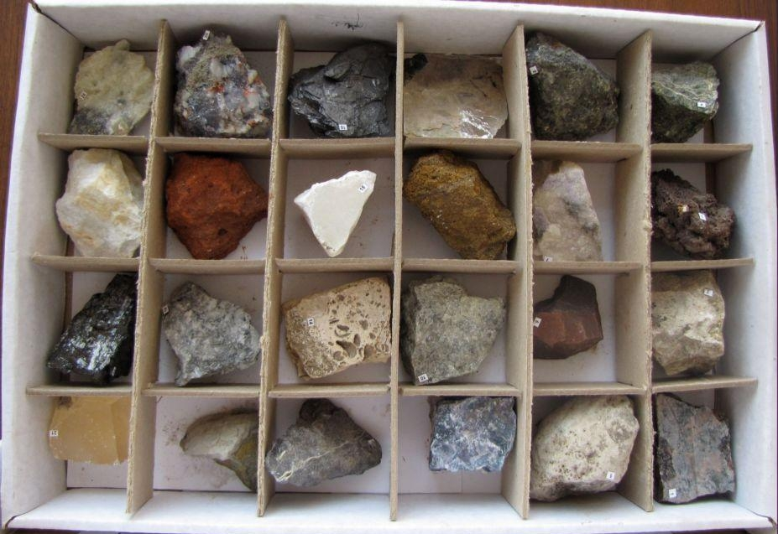
Mineralogical Sampling
It is used to determine the mineral composition of ore and hosting rocks.
In the process of testing, the form of finding valuable components in the ore is established, the balance of the distribution of the main components between the minerals is calculated.

Slide 5
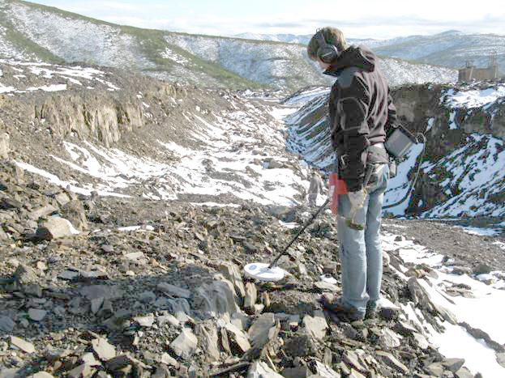
Geophysical Sampling
Methods. Various: magnetometric, nuclear-physical, radiometric.
Magnetometric methods are used to study magnetite ores. The most often used is the magnetic carat wells, to determine or refine the boundaries of ore bodies and determine magnetite in ore.
The nuclear-physical method consists in the activation of ores and rocks by various types of radiation, as a result of electrons or rocks of the rocks, ores, there is a response radiation, measuring which can determine the content of chemical elements in the ore.
Radiometric methods are based on the natural radioactivity of ores. Radiometers of various designs are used either in the wells gamma caratage is carried out, sometimes it is successfully used to dismember the section.

Slide 6
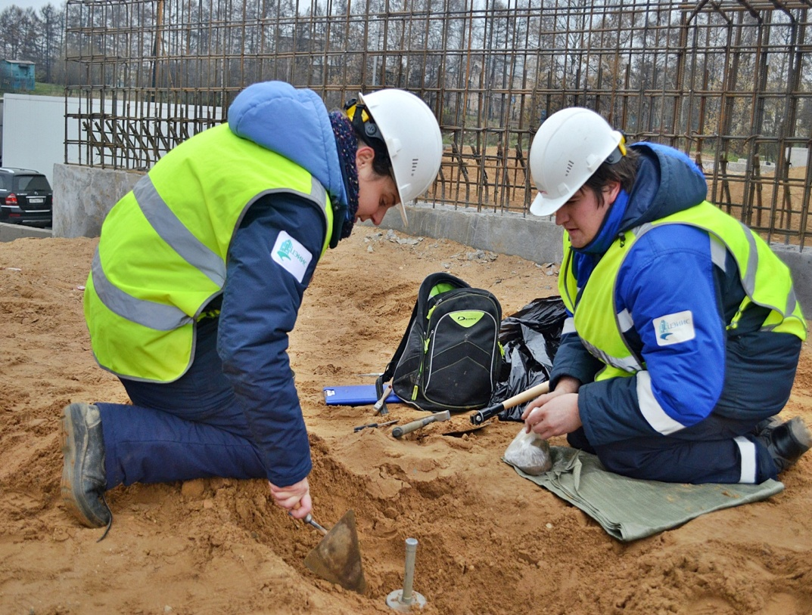
Technical Sampling
Is used to study the physical properties of pi.
The most commonly measured density, porosity, humidity and bulk density, i.e. Those properties that affect the exploration, extraction and processing of ore.
Of great importance are the strength properties of the ore, often determine the categories of drillability, the coefficient of loosening and lumpiness of ore. In loose p.i. The granulometric composition of the ore is studied.

Slide 7
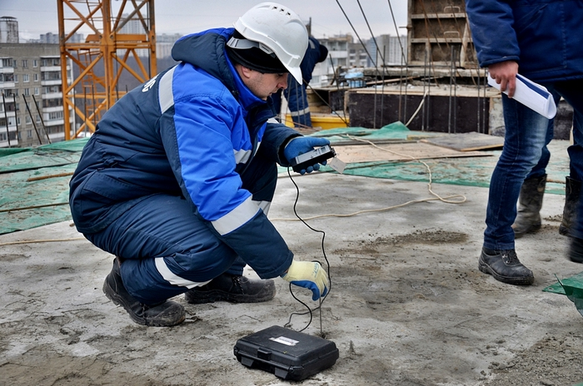
Technological sampling
Is spent for definition of the rational scheme of processing of mineral raw materials

